Slide 1
CHAPMAN LIBRARY
GENERAL ORIENTATION

Slide 2
ORIENTATION OVERVIEW
WELCOME TO THE LIBRARY
OPENING HOURS
THE LIBRARY HANDBOOK
Rules And Regulations
Baggage
Noisemaking
Eating and Dirking
Mutilating of Library Books
Dress Code
Classification of Library Books
Library Open Day
Newsletter (The Orient)
Brochure
Daily Alert
LIBRARY RESOURCE AND SERVICES
Resources
Offline Resources
Books
Journals
Magazines
Newspapers
Online Resources
Virtual Library
Online Databases
OPAC
Repository
LIBRARY AUXILIARY SERVICES
LIBRARY AND SOCIAL MEDIA
KNOW YOUR LIBRARY STAFF
Slide 2 of 25

Slide 3
WELCOME TO THE LIBRARY
Welcome to the new year 2019, and welcome to another semester. We are pleased that you can join the university, to study with us.
We at the Chapman Library have made the necessary preparations to ensure your smooth stay for the semester as you drink from the well of knowledge provided through our information resources and services.
Slide 3 of 25

Slide 4
OPENING HOURS
DAYS | OPENING | CLOSING
MONDAY - FRIDAY | 08:30 | 22:00
SATURDAY | 08:30 | 17:00
Slide 4 of 25

Slide 5
THE LIBRARY HANDBOOK
YOU ARE ENTITLED TO A LIBRARY HANDBOOK THAT YOU MAY DOWNLOAD FROM THE UNIVERSITY WEBSITE, UNDER THE LIBRARY SECTION. THIS IS YOUR GUIDE TO USE THE CHAPMAN LIBRARY
THE LIBRARY HANDBOOK HAS BEEN SUMMARIZED INTO THE ENSUING PRESENTATION.
Slide 5 of 25

Slide 6
THE LIBRARY HANDBOOK
RULES AND REGULATIONS
BAGGAGE
All baggage must be deposited with the library security, at its entrance when accessing the library.
You are responsible for any items you leave in your bag while deposited at the security. It is advised that all valuables be removed from the bag before handing it over at the security desk, as the library is not responsible for the contents of any bag.
You are to obtain a tag for your bag, which you are required to return as proof of keeping for your bag.
Slide 6 of 25

Slide 7
THE LIBRARY HANDBOOK
RULES AND REGULATIONS (Continuation)
NOISEMAKING
The library is a no-noise zone, mean for study and academic discussions. As such there should be no noise making whatsoever in the premises. The following are not allowed at the library, to ensure a serene atmosphere for study.
The use of phone, in making or receiving calls
Noisy Footwear, announcing the wearer’s presences when walking
Chatting, while walking to take a seat for your studies
Discussion where loud arguments are made
Slide 7 of 25

Slide 8
THE LIBRARY HANDBOOK
RULES AND REGULATIONS (Continuation)
EATING AND DRINKING
Due to the nature of our resources, food and drinks (including water) are not allowed into the library.
Water should be kept with baggage at the entrance
Food are not allowed for keeping at the security or any other part of the library
Patrons are advised that if for medical reason the need to take in anything while at the library, that appropriate arrangements be made with library staff for this. Kindly see the librarian for this arrangement, prior to bringing in any food or drinks to the library.
Slide 8 of 25

Slide 9
THE LIBRARY HANDBOOK
RULES AND REGULATIONS (Continuation)
MUTILATING OF LIBRARY BOOKS
Library books are not to be thorn, folded or written into.
The tearing of library books is an offense
Folding of books are prohibited
Writing or underlining books are not allowed.
You are to leave books on the table when you finish with them. Do not attempt to shelve them back as this would be done by the library staff.
Slide 9 of 25

Slide 10
THE LIBRARY HANDBOOK
RULES AND REGULATIONS (Continuation)
DRESS CODE
The university has a dress code policy, which is also followed at the library. Thus all dress banned on campus are not allowed into the library.
Please be mindful that you will be driven out if in a non-conforming attire, at the library.
Slide 10 of 25

Slide 11
THE LIBRARY HANDBOOK
RULES AND REGULATIONS (Continuation)
Other aspects of the Library Handbook should be obtained and adhered to by all patrons (users) of the library. Please download your copy from the Library section of the University Website.
Slide 11 of 25

Slide 12
CLASSIFICATION OF LIBRARY MATERIALS
FOLLOWING THE STANDARD
LIBRARY OF CONGRESS CLASSIFICATION (LLC) SYSTEM
All materials acquired by the library are calcified using the Library of Congress Classification System, which is the standard for education in the tertiary level. Other classification systems such as the Dewey Decimal Classification (also called Dewey Decimal) System, which is the organizing the contents of a library based on the division of all knowledge into 10 groups with each group assigned 100 numbers) are meant for lower levels such as primary and secondary schools.
Slide 12 of 25

Slide 13
CLASSIFICATION OF LIBRARY MATERIALS
A CLOSER LOOK AT THE LLC SYSTEM
LIBRARY OF CONGRESS CLASSIFICATION SYSTEM
The Library of Congress Classification System divides knowledge using alphabets and numbers. A summary table of the classification is displayed next:
Slide 13 of 25

Slide 14
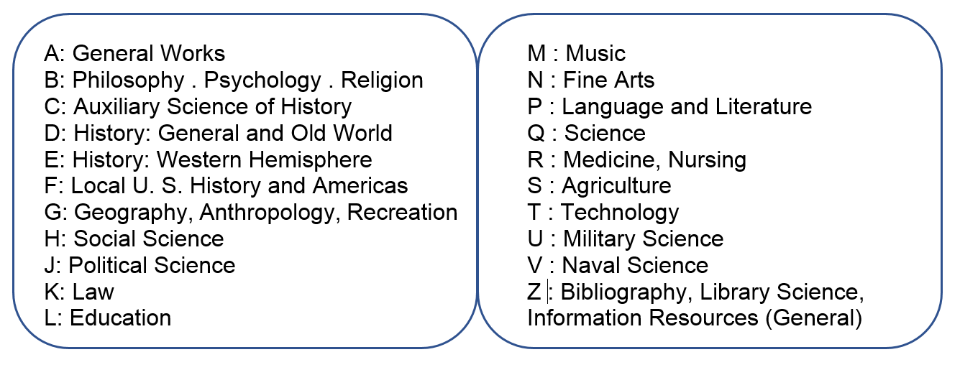
CLASSIFICATION OF LIBRARY MATERIALS
Slide 14 of 25

Slide 15
CLASSIFICATION OF LIBRARY MATERIALS
A CLOSER LOOK AT THE LLC SYSTEM
LIBRARY OF CONGRESS CLASSIFICATION SYSTEM
So for example, a book belong to the nursing category will be put under the R class.
The sub classes, where categorizations are narrowed down to will be observed with materials at the library. So with the given example a book belonging to the nursing category may be further narrowed to a sub category such as RC, which is Internal Medicine.
The call number is the unique label generated using the library of congress classification to identify a particular book.
Slide 15 of 25

Slide 16
CLASSIFICATION OF LIBRARY MATERIALS
Call Number
Book it Represents
Slide 16 of 25

Slide 17
CLASSIFICATION OF LIBRARY MATERIALS
LOOKING FOR A BOOK
SHELVING
All books have been shelved, arranging them from A-Z, in accordance with the international standards. To locate a book, you first need to know its call number. You may also browse to a category of books (as in our example nursing books), by going through that particular letter (in this example R), as have been arranged on the shelves.
The Chapman Library has two stack rooms, where books may be located. There is the West Wing for books A-B and the East Wing of books C-Z.
Slide 17 of 25

Slide 18
LIBRARY OPEN DAY EVENT
THEME - THE LIBRARY AND YOUR STUDIES
WEDNESDAY FEBRUARY 26, 2020.
The Library Open Day is an event that brings the Library and its users together, to give a insight into what the library has for these users.
This year the theme is the Library and your studies. There focus will be on what students can achieve with the library, in the pursuit of an academic degree at the university.
Slide 18 of 25

Slide 19
LIBRARY NEWSLETTER – THE ORIENT
2ND EDITION
AUGUST 2019 – JULY 2020
There is a Newsletter for the library, known as the Orient.
The Newsletter is mean to give students a general overview of the library and what to expect that coming year.
It presents the resources and services of the library, with some library training and a schedule of library events for the academic year.
Copies of the Newsletter can be downloaded from the library section of the university website.
Slide 19 of 25

Slide 20
LIBRARY NEWSLETTER – THE ORIENT
2ND EDITION
AUGUST 2019 – JULY 2020
There is a Newsletter for the library, known as the Orient.
The Newsletter is mean to give students a general overview of the library and what to expect that coming year.
It presents the resources and services of the library, with some library training and a schedule of library events for the academic year.
Copies of the Newsletter can be downloaded from the library section of the university website.
Pick up one from the Library’s Information and Security Desk.
Slide 20 of 25

Slide 21
LIBRARY BROCHURE
GENERAL EDITION
AUGUST 2019 – JULY 2020
The Library produces a brochure for each year, spelling out what the Library is about. It gives all patron a coincide account of resources and services as well as a summary of the library policies and procedures.
Obtain your copy of the current brochure from the library section of the university website.
You could also pick up a copy from the Library’s Information and Security Desk.
Slide 21 of 25

Slide 22
DAILY ALERT
CONTINOUS PROVISION OF INFORMATION
ABREAST WITH HAPPENINGS AROUD US.
Daily, the library will be updating the university with an alert that contains the following sections:
Chapman Library
National News – Education Section
International News pick
Newspaper Headlines for the day
The Daily Alert will be sent via e-mails and on the university website, from the library section.
It is ready by 10:00am every week day.
Slide 22 of 25

Slide 23
LIBRARY RESOURCES AND SERVICES
LIBRARY RESOURCES
The library has a number of resources listed as follows:
Books
Journals
Magazines
Newspapers
Academic Publications
Archive of university documents and events at CSUC
Resources are delivered via print and electronic means
Slide 23 of 25

Slide 24
LIBRARY RESOURCES AND SERVICES
LIBRARY RESOURCES
Books
The Library boas of some ten thousand books, across disciplines that are taught here at CSUC. These are in the category of Accounting, Banking, Computer Science, Computer Programming, Communication, Finance, Human Resource, Information Technology, Marketing Medicine, Midwifery, Nursing, Physician Assistance, Religion, Theology, etc.
There are also general books for reading in various areas.
Slide 24 of 25

Slide 25
LIBRARY RESOURCES AND SERVICES
LIBRARY RESOURCES
Books: Mode of Delivery
You can have access to our library books, when you walk in to use them
However to browse through the collection the library provides an Online Public Access Catalog (OPAC), which will assist you to locate the book in the library. To use the OPAC, log in to opac.csuc.edu.gh, from any internet browser.
You should have a screen as the ensuing:
Slide 25 of 25

Slide 26
LIBRARY RESOURCES AND SERVICES
Search Box
Libraries to Search
Login (For campus related features)
Search Criteria
Search Button
Slide 26 of 25

Slide 27
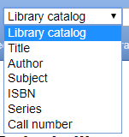
LIBRARY RESOURCES AND SERVICES
Search Criteria
This is how your search will be performed and it will be based on the criteria that you specify.
Other criteria are displayed in the extract below:
Slide 27 of 25

Slide 28
LIBRARY RESOURCES AND SERVICES
LIBRARY RESOURCES
Books: Mode of Delivery (Continuation)
The OPAC will give you the location of the book you may search, on our shelves. When books are located, they can then be picked up from the shelves.
The OPAC may also be used to “Place a book on Hold”, where books are reserved for a user. This may be so if the ready finds a book via the OPAC, but may come to the library and find out the book may have been borrowed between the time it was identified and the time the user came to the library. You must be a registered patron to use the system to reserve books. Kindly check from the library on how you may use this service.
Slide 28 of 25

Slide 29
LIBRARY RESOURCES AND SERVICES
LIBRARY RESOURCES
Books: Mode of Delivery (Continuation)
The library also has a few electronic versions of books in its Virtual Library system. With this system, patrons can download textbooks for their courses.
Thus the CSUC Virtual library project is a collection of our books that have been digitized.
Access the Virtual Library from the Library section of the university website.
Contact the library if you need to have a particular book added to the collection.
Slide 29 of 25

Slide 30
LIBRARY RESOURCES AND SERVICES
LIBRARY RESOURCES
Journals
Journals give current information, about an academic subject. A group of related journals are known as a database.
The chapman library has an offline and online database collections available to patrons.
Offline collections can be access in the our reading rooms and information commons (E-Library). Download a list of our current print database from the library section of our university website.
Slide 30 of 25

Slide 31
LIBRARY RESOURCES AND SERVICES
LIBRARY RESOURCES
Journals (Continuation)
Our online database as a subscription based service. The library subscribes for the service mainly through the Consortium of Academic and Research Libraries in Ghana (CARLIGH).
Other online database subscription are also available, for patron use.
Online database are more dependable for research and various literature assisted activities such as assignment and project works.
Slide 31 of 25

Slide 32
LIBRARY RESOURCES AND SERVICES
LIBRARY RESOURCES
Journals (Continuation)
The list of online database subscriptions can be accessed via the library section of the university website, where patrons can clicked on desired database and be redirected there to the journals that make up that database. Currently, the university subscribes to ten (10) of these databases with CARLIGH.
The ensuing screen show some popular database subscribed to by the university:
Slide 32 of 25

Slide 33
LIBRARY RESOURCES AND SERVICES
Slide 33 of 25

Slide 34
LIBRARY RESOURCES AND SERVICES
LIBRARY RESOURCES
Journals (Continuation)
Most of the database do not require the use of login credentials, as they are made available via our campus networks. See the librarian for any issues with usernames and passwords when asked to provide such.
Slide 34 of 25

Slide 35
LIBRARY RESOURCES AND SERVICES
LIBRARY RESOURCES
Magazines
The library subscribes to a few magazines, in various academic areas available in both print and electronic versions for patrons.
You may view the current status of magazines from the library section of the university website.
Kindly contact the library for details on these.
Slide 35 of 25

Slide 36
LIBRARY RESOURCES AND SERVICES
LIBRARY RESOURCES
Newspapers
The library subscribes to local newspapers as follows:
Daily Graphic
The Ghanaian Times
The Pioneer
Business and Financial Times
Graphic Business
Africa Watch Magazine
Slide 36 of 25

Slide 37
LIBRARY RESOURCES AND SERVICES
LIBRARY RESOURCES
Academic Publications: Repository
There are two main academic publications of the university and these are:
Faculty and Staff Publications
Students’ Final Thesis and Dissertations
Faculty and staff on campus have publications, which have been accepted as an addition to knowledge by different journal publishers, in different areas of study.
At the of a student’s program here in the university, you are usually required to construct a write-up (research work) in a particular area of interest.
Slide 37 of 25

Slide 38
LIBRARY RESOURCES AND SERVICES
LIBRARY RESOURCES
Academic Publications
All such publications are deposited into the university’s repository and may be accessed by the anyone, for the purpose of further research or acquisition of knowledge.
To access the University Repository log on to ir.csuc.edu.gh and have a screen like the one ensuing:
Slide 38 of 25

Slide 39
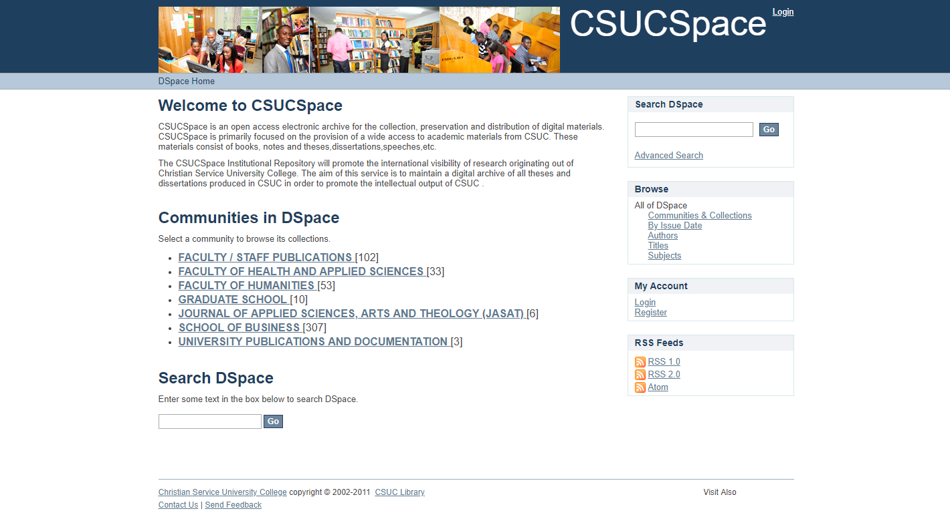
LIBRARY RESOURCES AND SERVICES
Slide 39 of 25

Slide 40
LIBRARY RESOURCES AND SERVICES
LIBRARY RESOURCES
Academic Publications: Repository (Continuation)
You may use the University Repository without the need to log in with any credentials. Logging in is for those who work on the repository, to update it.
There are other university documentations such as handbooks, brochures and archival documents that may be found at the repository. You will find other documents of the library here as well. Download your Library Handbook, Library Newsletter and other library documents from the university repository.
Slide 40 of 25

Slide 41
LIBRARY RESOURCES AND SERVICES
LIBRARY RESOURCES
Academic Publications: Repository (Continuation)
If you are a writer and could write something interesting for inclusion in our repository, send such (together with your details) to repository@csuc.edu.gh and you will be contacted.
Slide 41 of 25

Slide 42
LIBRARY RESOURCES AND SERVICES
LIBRARY SERVICES
In order to effective use the library resources, some services are provided by the library as listed below:
Personal Librarian Service
Library Training Sessions
Literature Assistance Services
Research Assistance Services
Slide 42 of 25

Slide 43
LIBRARY RESOURCES AND SERVICES
LIBRARY SERVICES - Personal Librarian Service
Service provided under this is meant to give a patron a university life-time assistance in information search and use.
Your personal library will help you throughout your stay here at CSUC.
Personal Librarians are assigned every year, so that each student will have a different personal librarian in a year.
Slide 43 of 25

Slide 44
LIBRARY RESOURCES AND SERVICES
LIBRARY SERVICES - Personal Librarian Service (Continuation)
To know your personal librarian, kindly contact the librarian. It is important that students show a need for a personal library, otherwise they are not assigned one. Thus even though you may be registered automatically to use the library, you may not have a personal librarian.
Personal librarians will help with information searching and general library use. They will also take you through topics that have been treated in training sessions if you need further assistance.
Slide 44 of 25

Slide 45
LIBRARY RESOURCES AND SERVICES
LIBRARY SERVICES - Training Sessions
The library organizes periodic training sessions for the entire CSUC academic community.
Students are organized into levels and departments for the training sessions.
A timetable, indicating the details of the training, can be seen on campus notice boards and can also be downloaded (in PDF) from the library section of the university website.
Slide 45 of 25

Slide 46
LIBRARY RESOURCES AND SERVICES
LIBRARY SERVICES - Training Sessions (Continuation)
Training sessions cover topics in the following major areas:
Information Literacy
Basic Computer Skills for Research
Reference Tools for Research
Academic Integrity
Slide 46 of 25

Slide 47
LIBRARY RESOURCES AND SERVICES
LIBRARY SERVICES - Training Sessions (Continuation)
Information Literacy (IL): IL seeks to give an overview of how to search for information, in our contemporary world of IT advancement and new discoveries.
Basic Computing Skills for Research: This is meant to have a hands on training on the use the computer in today’s information search.
Slide 47 of 25

Slide 48
LIBRARY RESOURCES AND SERVICES
LIBRARY SERVICES - Training Sessions (Continuation)
Reference Tools for Research: This training session introduces patrons to three groups of software for research as follows:
Research Organization and Reference tools such as Zotero and Mendeley.
Research Data Analysis tools such as SPSS and the R Statistical Software.
Academic Integrity: This trainings session is mean to give students an appreciation of academic integrity. Tools such as Turnitin and Dupli Checker are used here.
Slide 48 of 25

Slide 49
LIBRARY RESOURCES AND SERVICES
LIBRARY SERVICES - Literature Assistance Services
Literatures Assistance services is where the library assist patrons with seeking relevant information sources for their literature review. A step further is taken in giving patrons direct literature, according to their needs and requirements.
To use our literature assistant service, kindly fill the online form for this found at the library section of the university website.
Slide 49 of 25

Slide 50
LIBRARY RESOURCES AND SERVICES
LIBRARY SERVICES - Research Assistance Services
Literatures Assistance services provides patrons with their research work, be them final thesis or staff publications, as their needs and requirements may be.
To use our research assistant service, kindly fill the online form for this found at the library section of the university website.
Slide 50 of 25

Slide 51
LIBRARY AUXILIARY SERVICES
DEFINITION
Auxiliary Services are accessory services, that on a whole contribute to your comfortable stay at CSUC. At the library, auxiliary services include:
Photocopying
Printing
Scanning
Lamination
Binding
Type Setting
Video Editing
Auxiliary Services come at a fee. Please consult the library for details on this.
Slide 51 of 25

Slide 52
LIBRARY AND SOCIAL MEDIA
MEETING NEW GENERATIONAL NEEDS VIA SOCIAL MEDIA
The world today has many who depend on Information Technology tools for virtual all aspects of life.
Indeed the world today is oiled by technology.
An aspect of Technology on the rise is use of social media.
To better serve our patrons, the library uses a variety of social media tools in reaching out to patrons.
Social media tools include Facebook, Twitter, Instagram and WhatsApp.
Slide 52 of 25

Slide 53
LIBRARY AND SOCIAL MEDIA
CONNECTING VIA WHATSAPP
The library connects with different groups of patrons via the WhatsApp platform.
The library has commenced a WhatsApp training platform for the entire CSUC community of workers and students. The categories for students are as follows:
Slide 53 of 25

Slide 54
LIBRARY AND SOCIAL MEDIA
CONNECTING VIA WHATSAPP
Library with Post Graduate Students
Library with Undergraduate Students – Level 100
Library with Undergraduate Students – Level 200
Library with Undergraduate Students – Level 300
Library with Undergraduate Students – Level 400
To join any of the groups, please send a message to 0243223022.
Slide 54 of 25

Slide 55
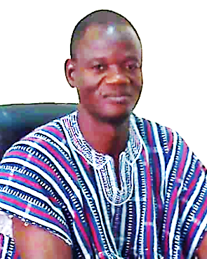
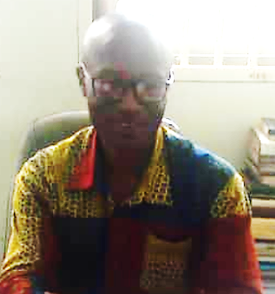
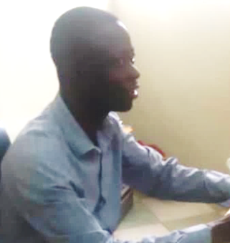
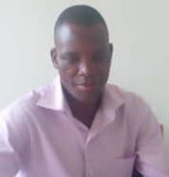
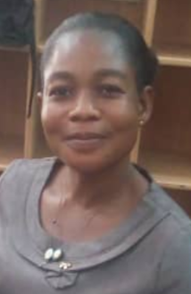
LIBRARY AND SOCIAL MEDIA
STAFF AT THE CHAPMAN LIBRARY
LIBRARIAN
Emmanuel O. Laryea
ASSISTANT LIBRARIAN
Matthew Ndeogo
CATALOGUER
Samuel Oti-Appiah
IT MANAGER
Eugene Azibana
USER SERVICES / REFERENCE
Frank Adoko
SECRETARIAL
Josephine Tiwaa
Slide 55 of 25

Slide 56
Slide 56 of 25

Slide 57
THANK YOU

